Slide 1





Pupil Collaboration Booklet
The Global Goals
Name: ________________________________

Slide 2

Lesson 1: What are the Global Goals?
Lesson Aims: To explore and explain the Global Goals
Instruction: Create a mind-map of the different problems that people may be experiencing around the world (e.g. poor healthcare)
My Mind Map
Instruction: Complete the two tasks below
What is a ‘Goal’?
Can you think of Five Global Goals that we want to achieve for EVERYONE around the world?
Page 1

Slide 3
Lesson 1: What are the Global Goals?
Lesson Aims: To explore and explain the Global Goals
Instructions: First, read the ‘Heroes for Change’ comic book which includes the 17 Global Goals to be achieved. Next, create your own panel with a superhero fighting for one of the global goals. You can find the comic book here "Heroes for Change" Comic Book
Which Global Goal is the most important to YOU and your community? Can you also explain why …
________________________________________________________________________________________________________________________________________________________________________________________________________________________________________________________________________________________________________________________________________________________________________________________________________________________________________________________________________________________________________________________________________________________________________________________________________________________________________________________________________________________________________________________________________________________________________________________________________________________________________________________________________________________________________________________________________________
Page 2

Slide 4
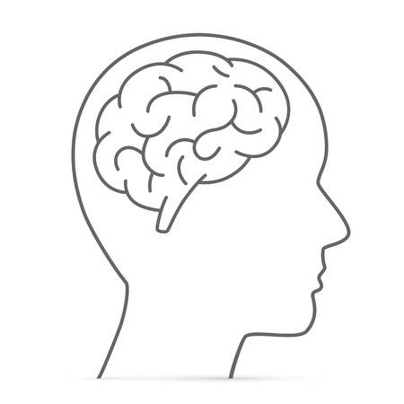

Lesson 2: How can we work towards Global Goal 2: Zero Hunger?
Lesson Aims: To understand why Zero Hunger matters on a local and global level
Instruction: Annotate the brain with what you know about Uganda. Annotate the thought cloud with what you think Uganda is like.

Slide 5

Lesson 2: How can we work towards Global Goal 2: Zero Hunger?
Lesson Aims: To understand why Zero Hunger matters on a local and global level
Instruction: Take a look at the photos of Uganda and the UK on the next slide and complete the boxes below
Uganda Photograph
What can you see?
UK Photograph
What can you see?
What does this tell us about the UK and Uganda?
____________________________________________________________________________________________________________________________________________________________________________________________________________________________________________________________________________________________________________________________________________________________________________________________________________________________________________________________________________________________________________________________________________________________________________________________________________________________________________________________________________________________________________________________________________________________________________________________________________________________________________________________________________________________________________________________________
Page 3

Slide 6
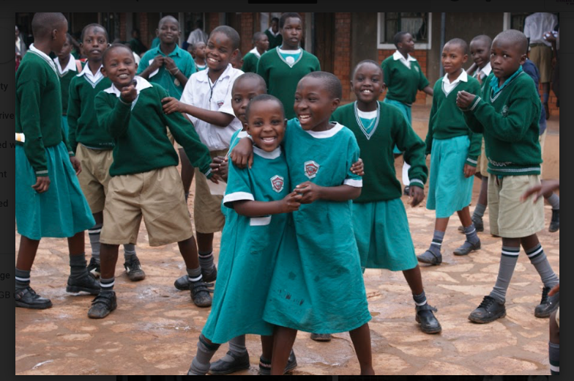
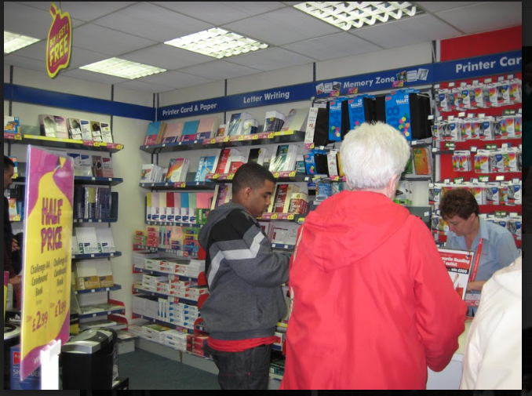
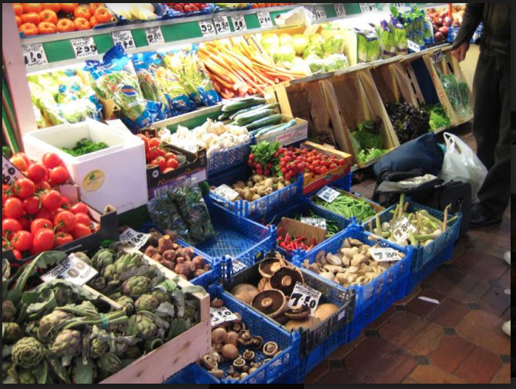
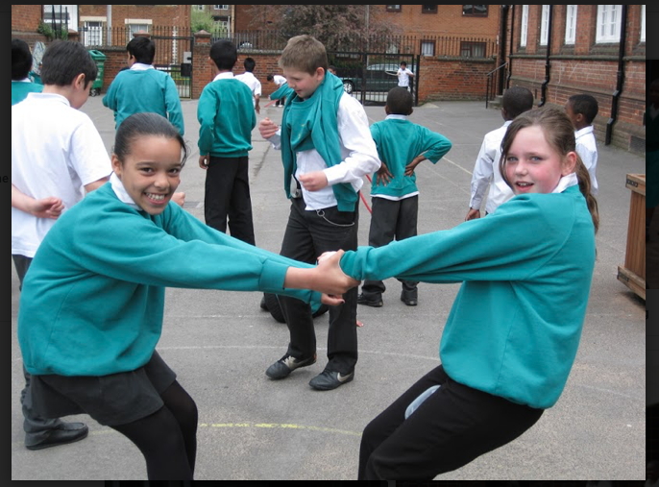
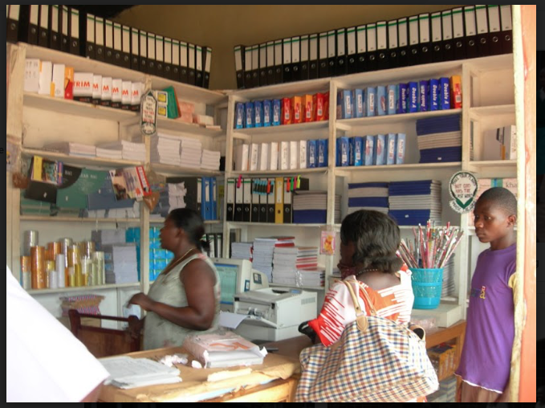
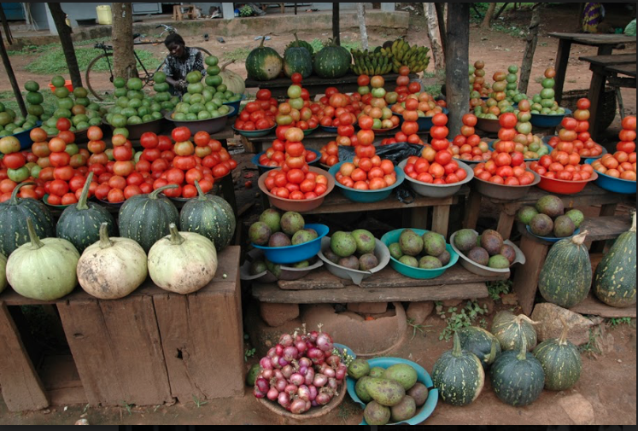

Slide 7


Lesson 2: How can we work towards Global Goal 2: Zero Hunger
Lesson Aims: To understand why Zero Hunger matters on a local and global level
How do we currently tackle hunger within our communities?
Life in Uganda
Life in Wales
Page 4

Slide 8
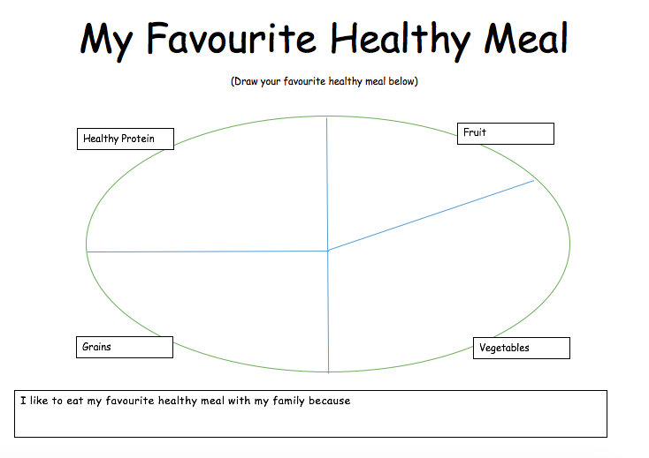
Lesson 3: What is traditionally eaten in the UK and Uganda and where does this food come from?
Lesson Aims: To identify where our food comes from and how far it travels to our plates
Instruction: Complete the plate below with a drawing of your favourite meal.
Page 6

Slide 9
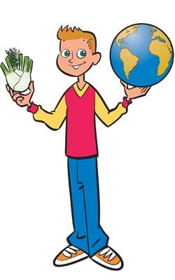
Lesson 3: What is traditionally eaten in the UK and Uganda and where does this food come from?
Lesson Aims: To identify where our food comes from and how far it travels to our plates
Instruction: Read the information below and complete the table at the bottom
Vegetables grow all over the world. If you can, you should buy vegetables and fruits that are grown locally and when they are in season - they are usually cheaper and they'll have the best flavour.
Whilst we buy most of our food from supermarkets, smaller food shops or markets, all of the food we eat must be grown, reared or caught. Some people also grow or rear food at home or on allotments.
Food is grown in an environment where light, food (soil) and water are available to them so they can grow and photosynthesise. Some farmers use large plastic tunnels to grow crops so that they are protected from the weather. Carrots and strawberries are often grown in polytunnels. Other farmers use hydroponics, where plants are grown without the use of soil and are instead grown in water. Tomatoes, peppers, cucumbers and lettuce are successfully grown this way.
Important facts:
    All food comes from plants or animals.
    Food has to be grown, reared or caught.
    Food is produced around the world.
    Food is changed from farm to fork.
    Food is processed on different levels to make it edible and safe.
The following ingredients are used to make a vegetable and goat’s cheese tart. State whether the ingredients are from a plant or animal and its name. The first one has been done for you.
Ingredient | Animal or plant | Name of animal or plant
Plain flour | Plant | Wheat
Hard cooking fat or butter
Mushrooms
Tomatoes
Sweetcorn
Peas
Red pepper
Goat’s cheese
Eggs
Milk
Black pepper
Page 7

Slide 10
Lesson 4: How do communities celebrate with food and feasts?
Lesson Aims: To explain the different ways in which communities celebrate with feasts
Instruction: Create a mind-map on the different features of a festival/ celebration. What is it? What’s involved? When does it take place?
What is a festival or celebration?
Can you think of any festivals or celebrations that you have within your community? | Can you think of any festivals or celebrations that other people may have around the world?
Page 9

Slide 11

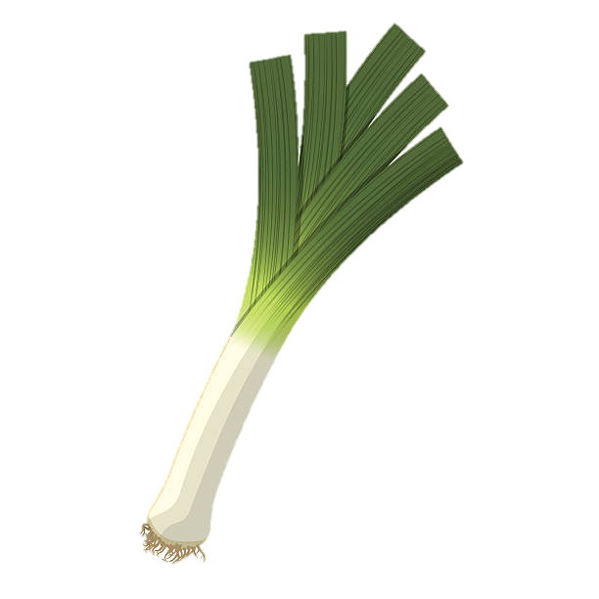
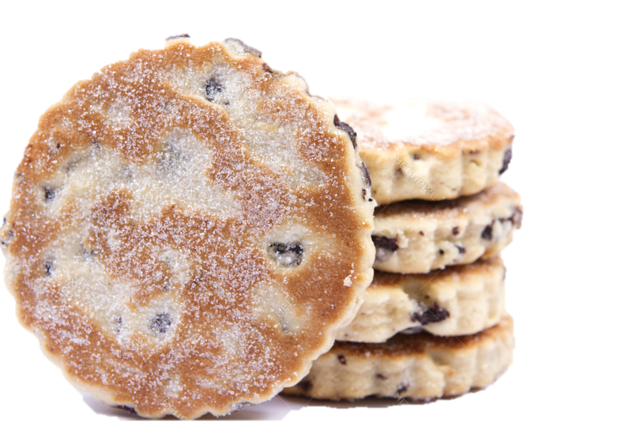

Lesson 4: How do communities celebrate with food and feasts?
Lesson Aims: To explain the different ways in which communities celebrate with feasts
        St David’s Day!
        St David is the patron saint of Wales and he is celebrated on the 1 March every year. To mark the day, Welsh people around the world wear one or both of Wales's national emblems - a daffodil and a leek. Special concerts and parades are also held in St David's honour. Patron Saints are chosen to be special protectors or guardians over all areas of life. England, Ireland and Scotland also have their own patron saint, to whom they dedicate a day.
Who was St David?
St David - or Dewi Sant in Welsh - was born on the south-west coast of Wales, near to where the city of St Davids is today. We don't actually know the exact year when he was born, but it is believed to be some time in between 462 and 515 AD. There are many stories about miracles happening around St David. One of the famous stories is from when he was speaking to a large crowd and someone in the crowd shouted: "We won't be able to see or hear him." Then, the ground David stood on is said to have risen up so that he was standing on a hill, making it easier for everyone to see him. It is said that he lived for more than 100 years and died on Tuesday, 1 March 589.
How is St David’s Day celebrated?
A National St David's Day parade is held in the centre of Cardiff every year, with lots of exciting performances by theatre groups. Many
children wear traditional Welsh clothing and take part in dances. Across the country, lots of towns and villages host their own parades and
concerts, with many people also cooking meals to celebrate. Traditionally, Welsh Cakes are eaten too!
3 Facts about St David
  1. He was a vegetarian! St David and his monks ploughed fields by hand and didn't eat meat. It is also believed that St David himself only ate leeks and drank water.
  2. His words live on! His last words to his followers before his death are thought to have been: "Be joyful, keep the faith and do the little things that you have heard and seen me do." The phrase gwenwch y pethau bychain mewn bywyd - 'Do the little things in life' - is still a well-known phrase in Wales.
  3. He left his mark! It is said that he went on a special religious journey to Jerusalem and brought back a stone with him. The stone now sits on an altar in St David's Cathedral, which was built on the site of David's original monastery.
Learn to speak Welsh!
Bore da (Boh-reh dah) - Good morning
Prynhawn da (Prin-houn dah) - Good afternoon
Croeso I Gymru (Croy-so ee Gum-ree) - Welcome to Wales
Diolch (Dee-olch) - Thank you
Dydd Gŵyl Dewi Hapus (dee-the goil De-wi ha-peece) - Happy St David's Day
Page 10

Slide 12


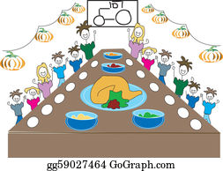
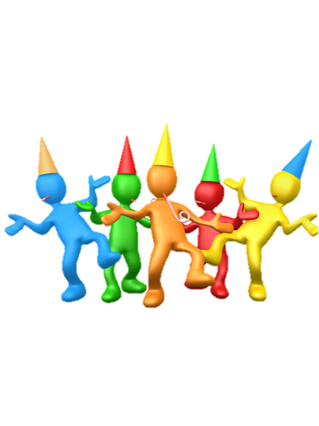
Lesson 4: How do communities celebrate with food and feasts?
Lesson Aims: To explain the different ways in which communities celebrate with feasts
Instruction: Create an invite to a feast/ festival or celebration of your choice. This could be a birthday, wedding, Christening, Bar Mitzvah, Halloween party, or anything else you’d like to celebrate!
Planning Page
Page 11

